Slide 1

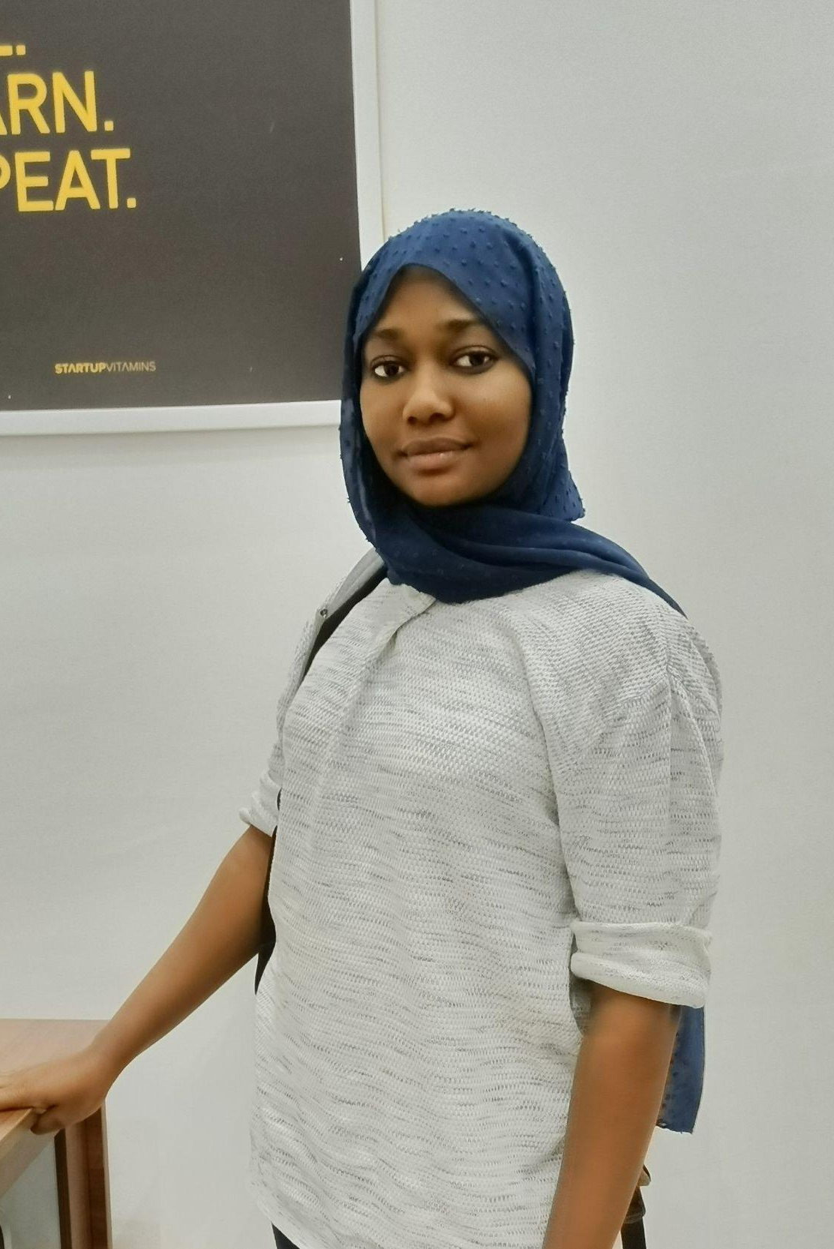
Building Accessible Web Experiences.
Fatima Muhammad

Slide 2

“Accessibility is about making things work for as many people as possible”
-W3C Web Accessibility Initiative

Slide 3

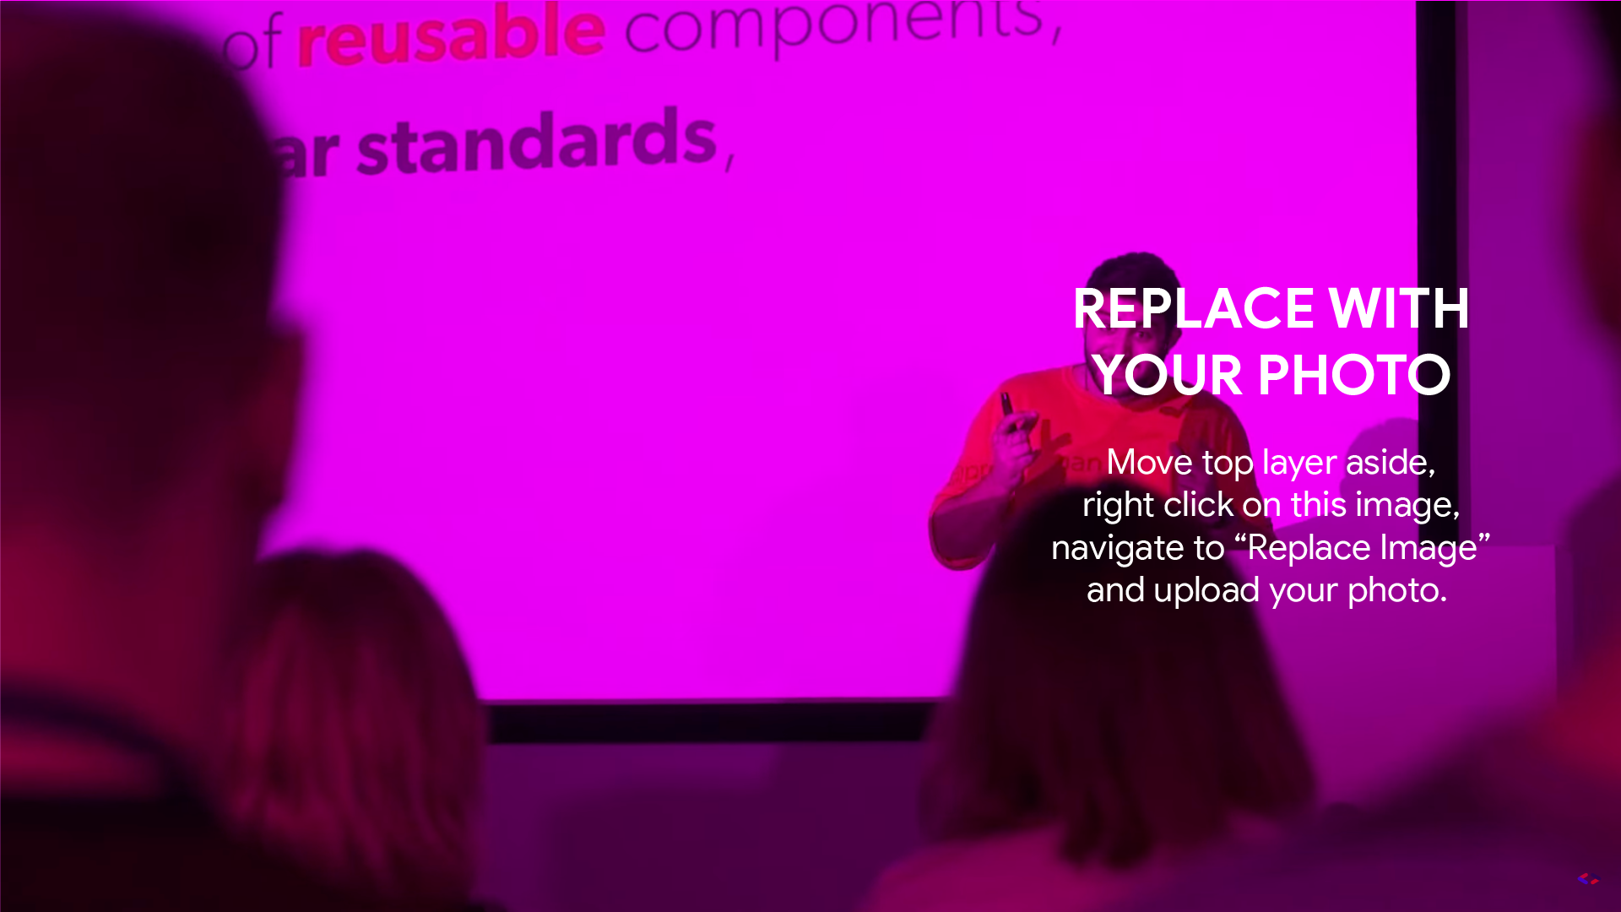
Building an Accessible web experience is like building a universally accessible playground.

Slide 4
Just like a playground
Just like a playground, building an accessible web experience can be likened to creating an inclusive and welcoming space for all users.
Inclusive designs
Navigable Pathways
Adaptive equipment and support
Safety measures
Continuous maintenance
Community involvement

Slide 5

The Key Principles of Web Accessibility.

Slide 6
The “POUR” principle
Web accessibility is guided by a set of principles outlined in the Web Content Accessibility Guidelines (WCAG) developed by the World Wide Web Consortium (W3C). These principles are organized into four main categories, often referred to as the "POUR" principles, representing that content should be:

Slide 7

Perceivable: Information and user interface components must be presented in a way that users can perceive. This includes providing text alternatives for non-text content, captions and other alternatives for multimedia, and making sure that content is adaptable and distinguishable.
Operable: This involves making all functionality available through a keyboard, providing users with enough time to read and complete tasks, avoiding content that could cause seizures or physical discomfort, and designing navigable, predictable, and consistent interfaces.
Understandable: Information and the operation of user interface must be understandable. This principle includes creating legible, readable text; designing consistent and predictable navigation and functionality; and input assistance to prevent and correct errors.
Robust: Content must be robust enough that it can be reliably interpreted by a wide variety of user agents, including assistive technologies. This involves using valid code, ensuring compatibility with current and future technologies, and providing fallbacks for when technologies are not supported.

Slide 8

3 actionable tips for developers

Slide 9
Use Semantic HTML tags
Using semantic HTML tags improves accessibility, and makes ones code clearer. It also helps enhances seo searches. What we mean by using semantic html includes the use of <main>, <section>, <headers>, <div>, <nav>, <footer>, <article>, etc.

Slide 10
2. Implementing Aria attributes
ARIA, which stands for Accessible Rich Internet Applications, is a set of attributes that can be added to HTML elements to improve the accessibility and usability of web content. Examples of some popular ARIA attributes includes:
“aria-label”, “aria-disabled”, “aria-hidden” and aria-roles like “role-navigation”, “role-button”, “role-form”

Slide 11
3. Prioritize Keyboard Navigation
Prioritizing keyboard navigation is crucial for creating an inclusive and accessible web experience. Many users, including those with disabilities, rely on keyboard input as their primary means of interacting with websites. Bottom line, it improves user’s experiences.

Slide 12

Real-life examples of websites with Accessible Web Experiences.

Slide 13
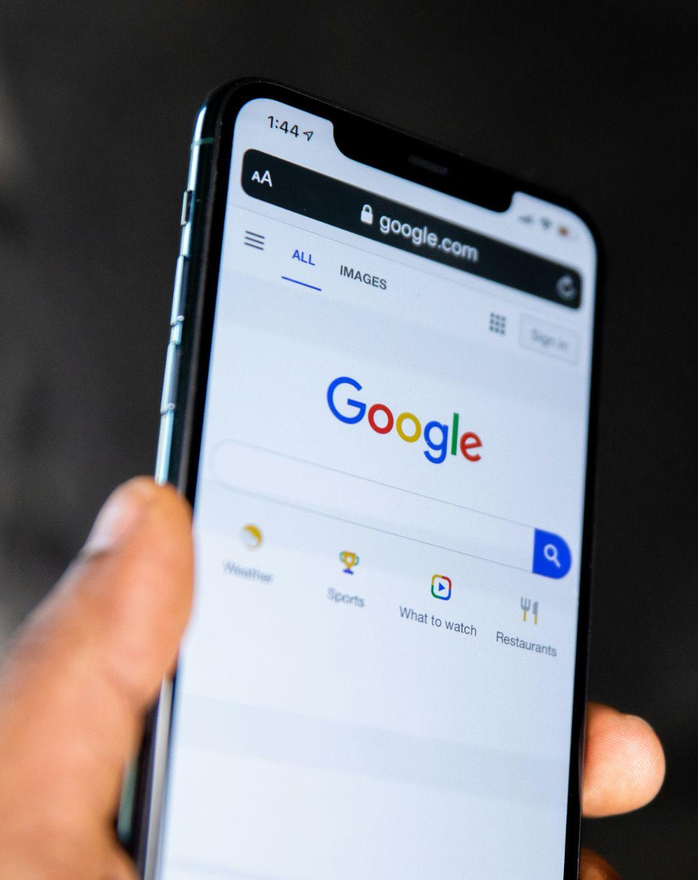
Google:
It has one of the best user-experience as even a layman can make a search on google. It is simple and easy to use.

Slide 14
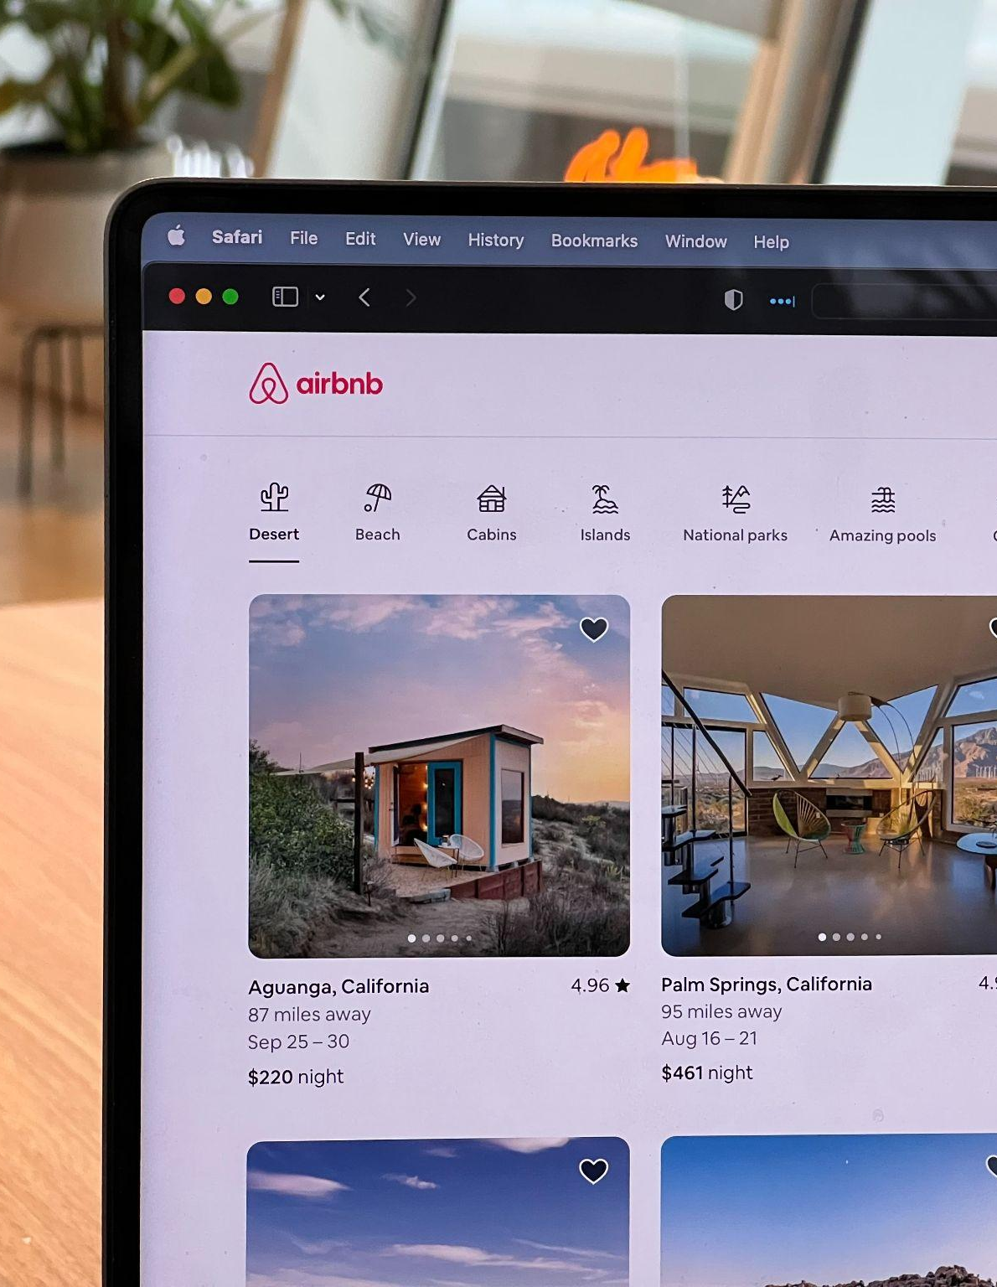
Airbnb:
Airbnb has a very inclusive design principle and an easy and straightforward navigation, allowing users find and book accommodation seamlessly.

Slide 15

BBC News:
BBC News website has a structured layout that makes it easy for users including those using screen readers. They also provide captioned videos and alt text for images for those users with hearing and visual impairments.

Slide 16
Solutions to Common Challenges in implementing accessibility
Updating legacy systems and technologies to be more inclusive and accessible.
Prioritize responsive design, test websites on different devices, and ensure that all interactive elements are accessible through touch and keyboard input.
Test and ensure compatibility with major browsers. Implement feature fallbacks or polyfills when necessary to address inconsistencies.
Review and update content regularly. Provide documentation and guidelines for maintaining accessibility as part of ongoing content management.
Proper research on accessibility should be conducted before embarking on a project.

Slide 17

As technology continues to advance, our dedication to ensuring that everyone, regardless of ability, exposure and knowledge can access and interact with online content becomes increasingly crucial.
It is important for us to understand that the web is a shared space, and its potential is truly unlocked when everyone, can participate fully. So therefore, on our part as developers, taking time to implement accessible and user-friendly experiences becomes a priority in what we do.
In Conclusion

